Slide 1
Multimedia Environment
Computer Vision
By Niloufar Kashefi

Slide 2
Table of contents
01
02
03
Introduction
Image as a matrix
Roadmap

Slide 3

01
Introduction

Slide 4
Image Processing
Computer Vision
Machine Vision

Slide 5
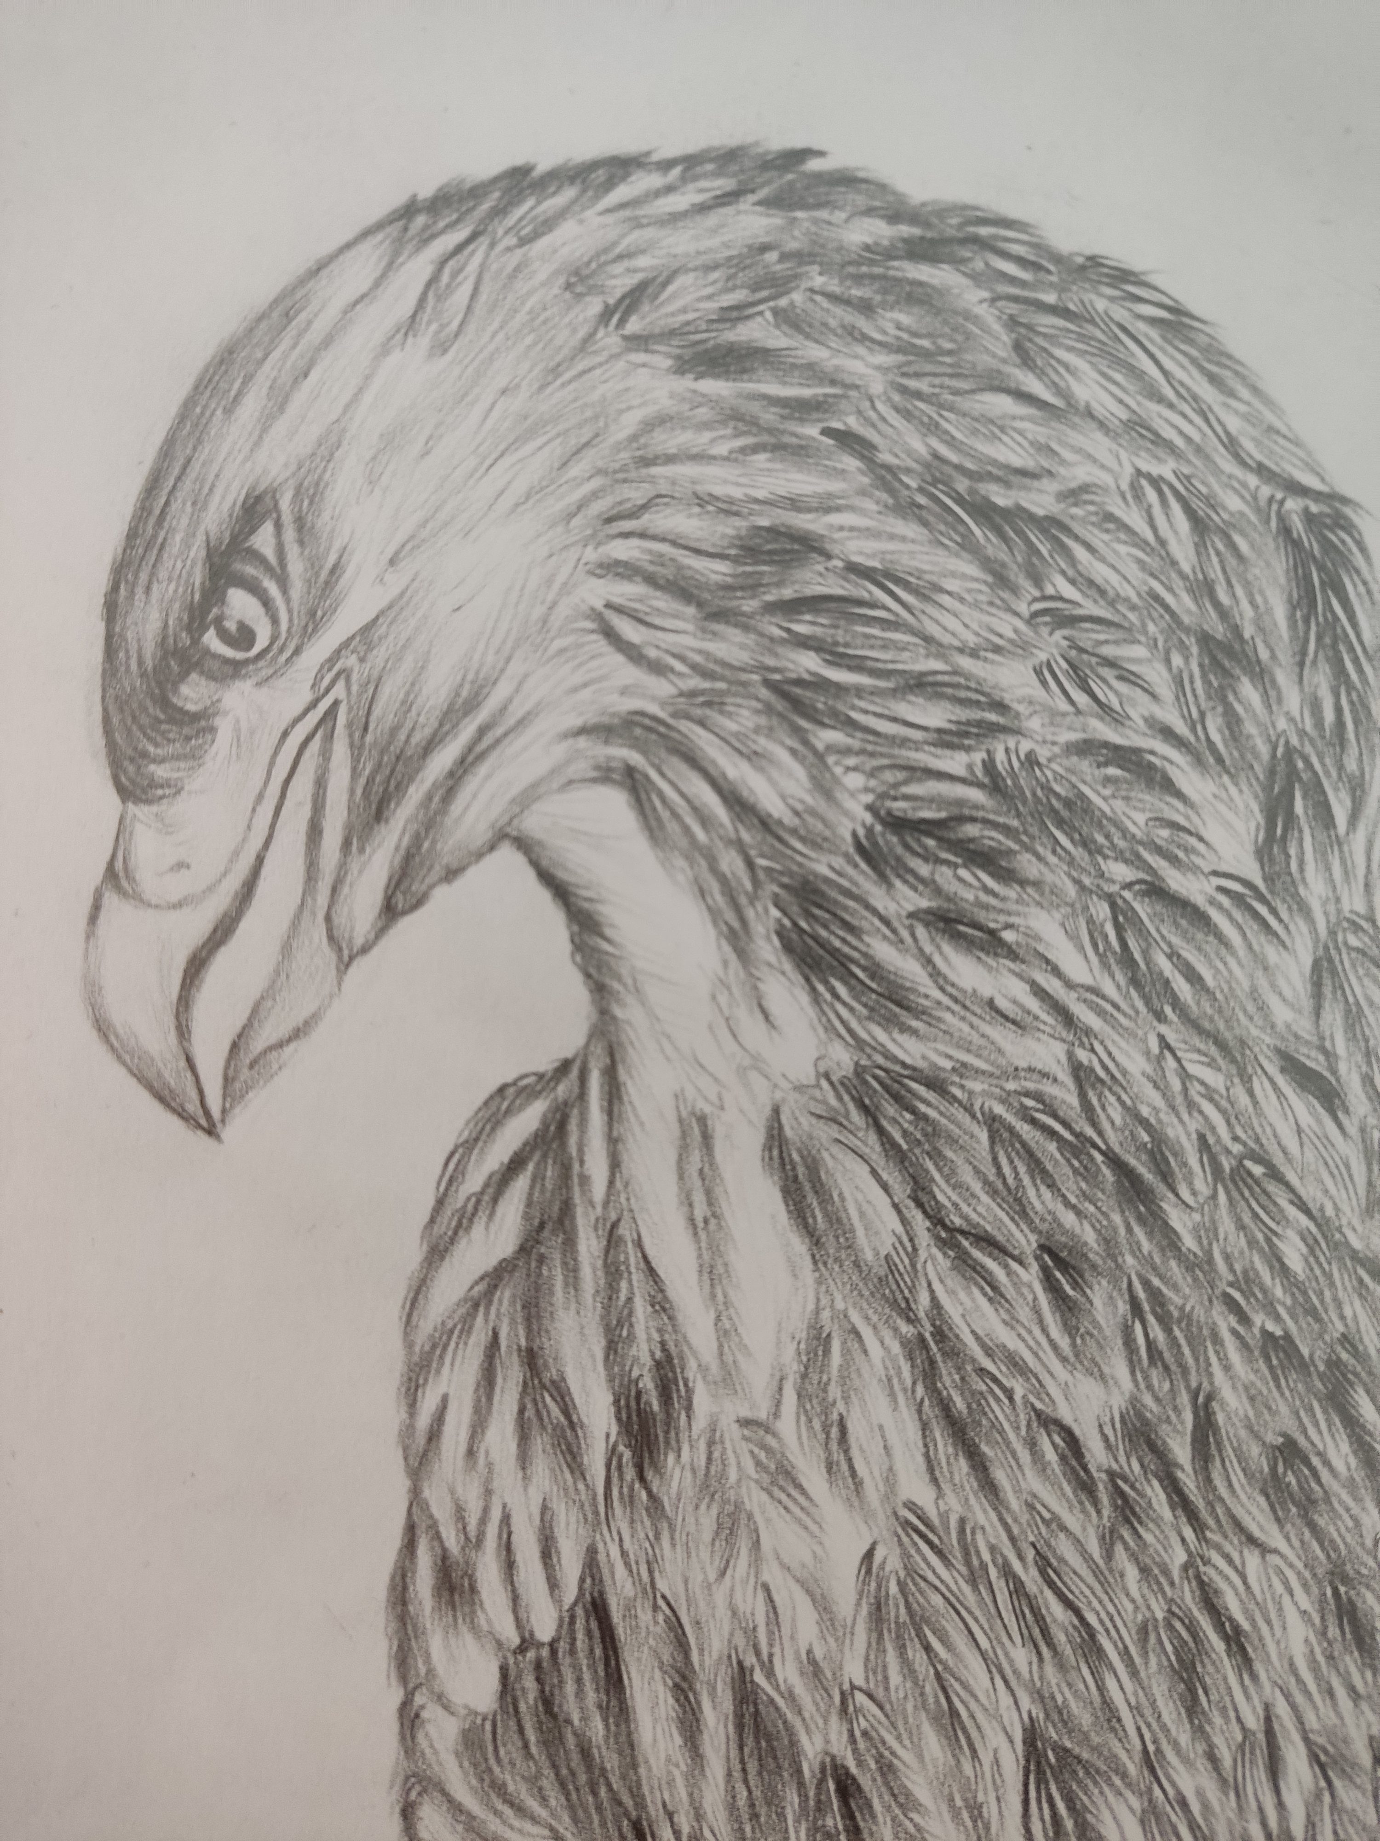
????
10011110

Slide 7
210 210 212 ……..
209 213 207 ……..
……..
……..
……..
n*m
n*m

Slide 8

n*m
Red
Green
Blue
210 210 212 ……..
210 210 212 ……..
210 210 212 ……..
209 213 207 ……..
209 213 207 ……..
209 213 207 ……..
……..
……..
……..
……..
……..
……..
……..
……..
……..
n*m
n*m
n*m

Slide 9

Our Roadmap
Python
Linear Algebra
Python libraries
  NumPy
  Pandas
  Matplotlib
  OpenCV

